Slide 1
Dreams, Dreaming and the Subconscious

Slide 2
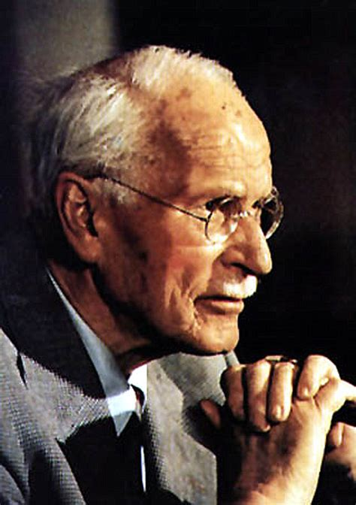
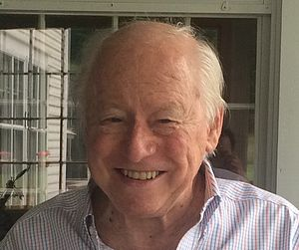
The schism :
VIENNA vs
MIT & CAMBRIDGE
Notes:
Helmholtz machine
2012
To bolster the argument that offline optimization is necessary, the authors argue that without periodic offline repair (pruning), the model will become overly complex and dysfunctional, thus reviving the old idea of Francis Crick that REM dreaming represents a purging or pruning of superfluous associations and complexity in the cognitive system. “In short, taking the brain off-line to prune exuberant associations established during wakefulness may be a necessary price we pay for having a sophisticated cognitive system that can distil complex and subtle associations from sensory samples.”

Slide 3

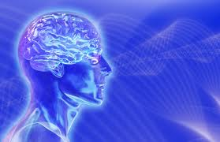
What is the Mind?
Make some notes, share with your neighbors:
  Do minds have parts?
  If so, how would you describe them?
  What is a mind like?
  What are the properties or characteristics?
  How does the mind relate to the brain, and body?
  Is mind different from the brain?
  Where does it start, where does it end?

Slide 4
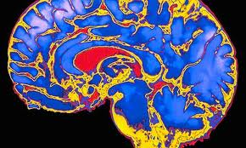
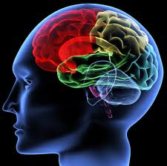
“You have been entrusted with the care and feeding of the most extraordinary and complex creation in the universe.
Home to your mind and personality, your brain houses your cherished memories and future hopes.
It orchestrates the symphony of consciousness that gives you purpose and passion, motion and emotion.”
(Quote from Franklin Institute for Science Learning)
Notes:
http://www.quantumconsciousness.org/presentations/whatisconsciousness.html

Slide 5
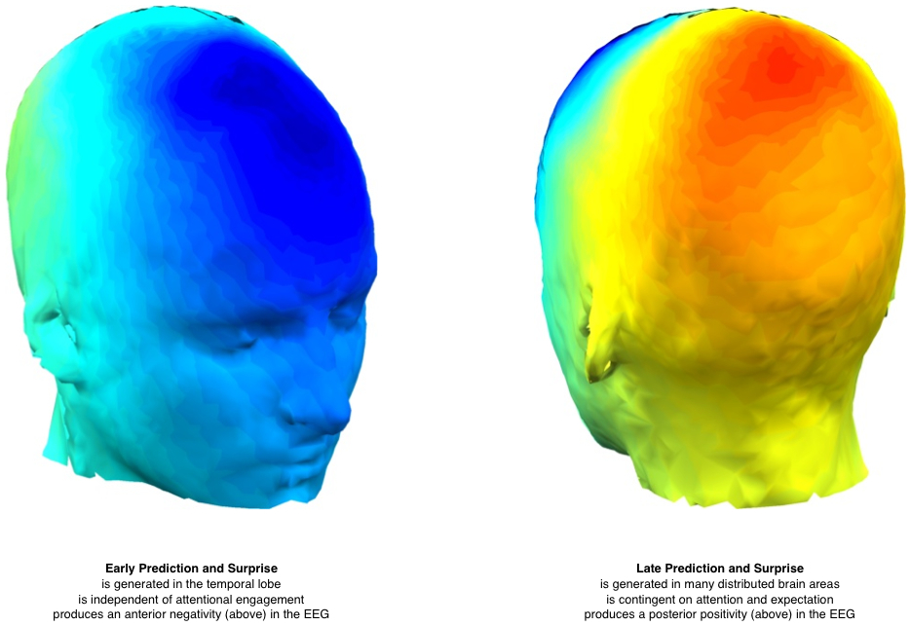
The brain as a predicting machine
Being on the same wave length
We anticipate speech for a better understanding
Notes:
The human brain is an advanced prediction machine. By this view, “the sophistication with which brains perceive and act upon the world has evolved to minimize the amount of surprise, or unpredictability experienced in a particular situation. Recent advances in neuroscience have generated new theoretical understanding about this intuitive notion, and there is a growing consensus that predictions about the future are realized in the brain by a hierarchy of successively complex neural processes that continually exchange information. Working together, this hierarchy maintains a constantly updated set of beliefs about the causes of events in the external world.”
Via: S. Chennu, V. Noreika, D. Gueorguiev, A. Blenkmann, S. Kochen, A. Ibáñez, A. M. Owen, and T. A. Bekinschtein The Journal of Neuroscience, 33(27):11194–11205, 2013.

Slide 7

Marc Chagall
Cow with a Parasol
Cows have different meanings to different people, in different cultures.
Any image will have a different meaning depending on the dreamer and the context.

Slide 8

Marc Chagall
His paintings have a few distinct images in an unlikely association that would be bizarre in real life, but typical of images we see in dreams.
His spontaneity and ability to express a dream-world is why his work is so loved

Slide 9
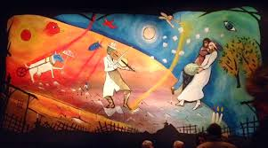
Curtain, inspired by Chagall, for theatre performance of Fiddler on the Roof

Slide 10

individuation
https://www.youtube.com/watch?v=9CEr2GfGilw
http://psychology.about.com/od/sensationandperception/ig/Optical-Illusions/spinning-dancer-illusion.htm
https://en.wikipedia.org/wiki/Spinning_Dancer

Slide 11
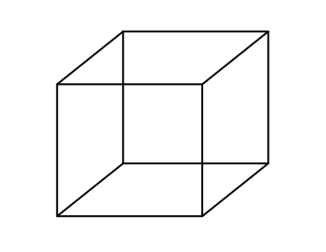

Bistable Perception /Multistable Perception
Rubin face-vase illusion
Necker Cube
Both images are bistable perceptions, in which the brain spontaneously
switches between two interpretations of the same ambiguous stimulus

Slide 12

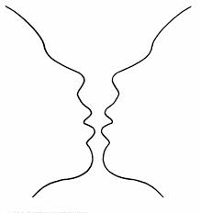
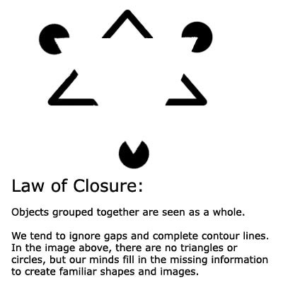
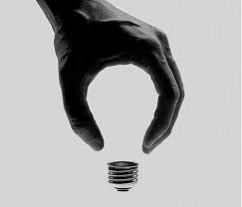
Gestalt Laws of Perceptual Organization
Our brains ignore contradictory information and fill gaps in with information.
Confabulation: (Psychology )
To fill gaps in one's memory with fabrications that you believes to be facts.

Slide 13

THE MISSING HORIZON
Individual Perception & perspective

Slide 14
POP-PSYCHOLOGY and myths
We only use 10% of our brain
That we’re left brain or right brain thinkers

Slide 15
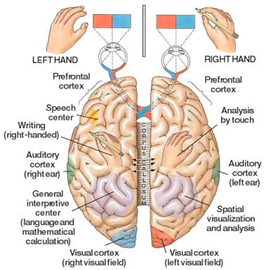

Slide 16
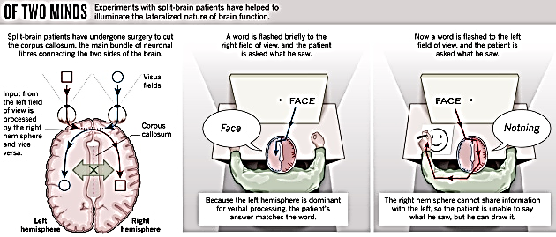
The Split-Brain (Gazzaniga & Sperry at Cal-Tech)
Wins a Nobel Prize 1981
10 minutes
4 minutes
https://www.youtube.com/watch?v=lfGwsAdS9Dc
https://www.youtube.com/watch?v=ZMLzP1VCANo

Slide 17
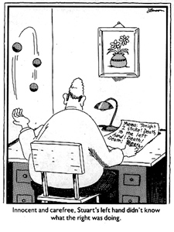
Neuropsychology: Left Brain Narrative (The Interpreter)
similar to the theories of Psychology theory of Confabulation
and the Gestalt idea of completion
The interpreter in our left hemisphere
constructs a story about why we act the way we do
constructs our conscious reality
conscious life is a (constructed) "afterthought"
Thousands/millions of brain activities are relatively independent of independent of one another
outside the realm of conscious experience.
they affect body movements, emotions, thoughts, ....
However, once the brain activity is expressed, the expressions become events that the conscious system takes note of and that the interpreter must explain.

Slide 18
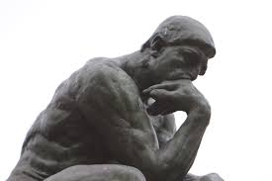
The left hand doesn’t know what the right hand is doing?
Decides there is a final stage that pulls information together
Wins a Nobel Prize 1981
Note that the theory of Left Brain Narrative is similar to Confabulation
http://www.medclip.com/index.php?page=videos&section=view&vid_id=103271

Slide 19
Split-Brains
Dr. Gazzaniga:
“The brain isn't like a computer, with specific sections of hardware charged with specific tasks. It's more like a network of computers connected by very big, busy broadband cables. The connectivity between active brain regions is turning out to be just as important, if not more so, than the operation of the distinct parts.”
Experiments have shown:
It was commonly believed that the left brain is analytic and the right brain is artistic but fMRIs shows that specialized tasks engage networks across the entire brain
That each half of the brain can function independently
That while each brain can act independently, with communication they can work together
That each half of the brain can compensate for the other half
Dr. Gazzaniga talks about the story we create:
https://www.youtube.com/watch?v=ZMLzP1VCANo

Slide 20
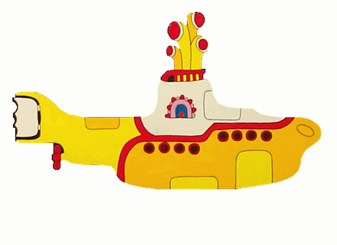

Dr. Michael S. Gazzaniga: Split brain research
Hmmm. Who’s driving the submarine?
https://www.youtube.com/watch?v=m2x-0_yXvZk
https://www.youtube.com/watch?v=FZLIcQf47TQ

Slide 21

Dream Theory # 1
The Evolutionary Theory
We Dream to Practice Response to Situations
Antti Revonsuo
Activity of the amygdala increases
The brain fires as if it’s in a
real life situation
The brain activity for motor skills increases- firing in a way that it’s practicing motor skills like running or jumping
In the safety of night, we practice survival skills
We rehearse fight or flight situations

Slide 22
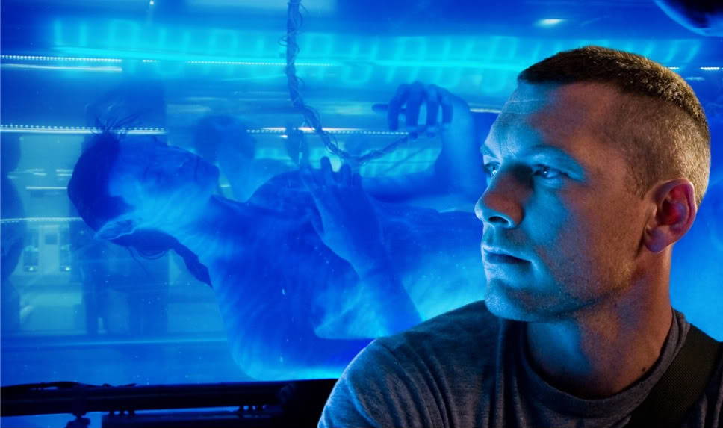
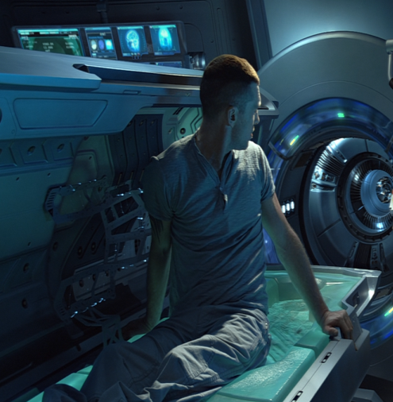
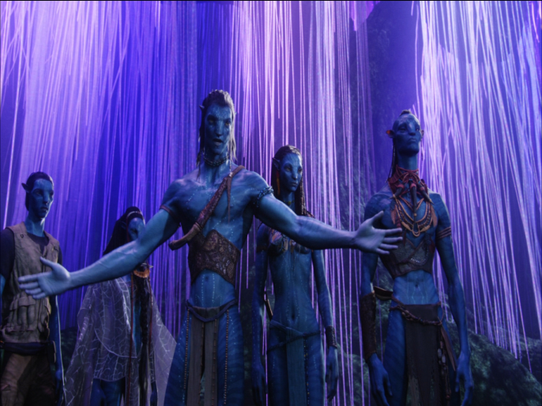
Who is the real
Jake Sully?
Critical Thinking Questions:
is the mind part of the brain and body?
If they are distinct, how do they interact?
Does the answer change the way we learn, engineer robots or design tech? Should robots have the same rights as humans?
In what ways does this change or affect identity and the idea of who you are and how you got to be that way?
How vast is the mind?
Is there a collective mind?
If some of our brain is not active when we’re dreaming, and our body is paralyzed, do we become less connected to our body and identify more with our mind?

Slide 23

Attention
Reality
Memory
why do dreams seem real?
Notes:
why do dreams seem real?

Slide 24

attention
Reality memory

Slide 25
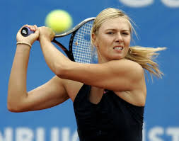
Coma patients
http://www.scientificamerican.com/article/do-brain-scans-comatose-patients-reveal-conscious-state/
Notes:
See monkey, see monkey do

Slide 26
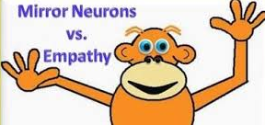
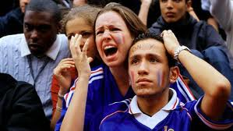
Mirror Neurons a fascinating new area in the early stages of study
Mirror neurons do not mean these neurons have a Theory of Mind/empathy
One theory is mirror neurons merely facilitate learning through imitation
The TPJ is not part of the mirror neuron network (Rebecca Saxe research)
Why do we cry at the movies?
See Monkey, See Monkey Do
http://www.pbs.org/wgbh/nova/education/body/mirror-neurons.html
Mirror Neurons and Intention
http://www.youtube.com/watch?v=Tq1-ZxV9Dc4
>>> Did he prime me to want water, or were my mirror neurons imitating him?
Podcasters, Stuff You Should Know explain mirror neurons:
http://science.discovery.com/tv-shows/stuff-you-should-know/videos/stuff-you-should-know-mirror-neurons.htm

Slide 27

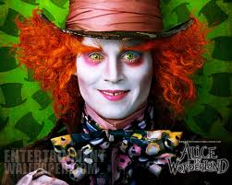


MRI: your brain watching a movie
Harry Potter
https://www.youtube.com/watch?v=7yjHiVfMSHk&list=UUbDdmTlTwoCUx2p7nScbUCw&index=10
Avatar
http://www.youtube.com/watch?v=KSKIkXvqruI&list=UUbDdmTlTwoCUx2p7nScbUCw&index=4&feature=plcp
Alice in Wonderland https://www.youtube.com/watch?v=1BWWkXdOui4&index=5&list=UUbDdmTlTwoCUx2p7nScbUCw

Slide 28
Memory
Reality
Attention
Is identity or your idea of self a summary of your memories?
Is identity/self where you put your attention?
Why are we different personas when we dream?
Notes:
why do dreams seem real?

Slide 29

If a tree falls in your dream, why does it make a sound?

Slide 30


Where the wild things are
https://www.youtube.com/watch?v=uNJPSc_4RCI
http://www.traileraddict.com/trailer/where-the-wild-things-are/feature-trailer
Notes:
Night terrors:
Young children don’t know that dreams are not real

Slide 31
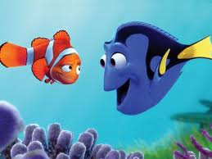
Memory
3 systems:
        Short term- active memory
                7 things
                7 seconds – 30 seconds
        Sensory- from senses and experiences
        Long term- is stored memory
                About 86 billion neurons in a brain
          Explicit (declarative) Conscious
          Implicit (procedural) Subconscious

Slide 32
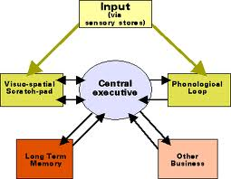
Memory
Working Memory
Central Executive, Prefrontal lateral cortex (PFC)
        WM includes Short Term Memory
        attention
        But not all memory goes
        to long term Memory
Some memories are never in dreams- can you guess why??

Slide 33
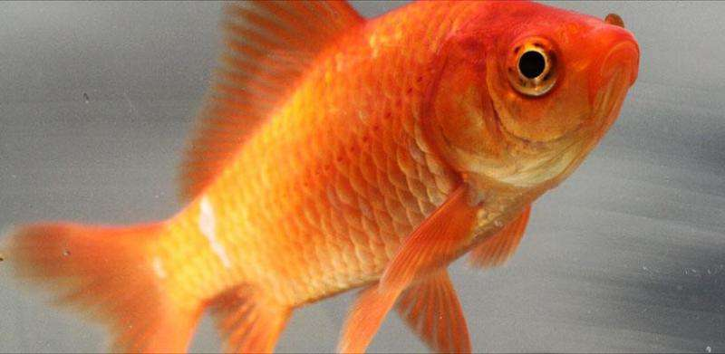
The attention span of a goldfish
Who has a longer attention span?
A tech-savvy person or a goldfish?
Notes:
http://medicalxpress.com/news/2015-05-microsoft-human-attention-span-lags.html
In analyzing the data obtained, the researchers found that the average attention span for the respondents and volunteers was just eight seconds, down from twelve back in 2000, and one second shorter than the average goldfish. They also found that using digital devices has caused an improvement in multi-tasking skills.

Slide 34
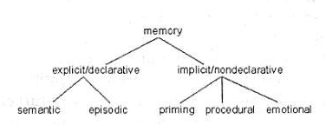
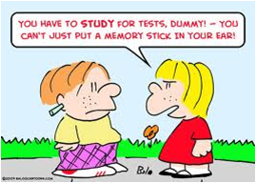
EXPLICIT MEMORY IS CONSCIOUS:
Explicit Memory is the deliberate recollection of a memory; we have to work to remember it. It’s specific, the kind of memory we think about or draw upon countless times a day
Episodic (long-term)
Specific
Autobiographical
Emotional
Includes flashbulb memory
Semantic (long term)
General knowledge
Not unique to individual

Slide 35
Explicit Memory/Declarative
Declarative Memory: information you consciously recall and can explain
Episodic (long-term)
Long term memories of specific events, such as what you did yesterday or when you got your drivers license
Specific
Autobiographical
Emotional
Includes flashbulb memory
Semantic (long term)
Memories of facts, concepts, names, and other general information.
General knowledge
Not unique to individual

Slide 36
Implicit Memory/nondeclarative
Things that we don't purposely try to remember are implicit
both unconscious and unintentional.
sometimes referred to as nondeclarative memory because you are not able to consciously bring it into awareness
PRIMING:
If I wear Nike sneakers I can run faster
Pit bulls are dangerous dogs (not true!)
PROCEDURAL:
Riding a bicycle
Making toast
EMOTIONAL:
I run into the house when I see a coyote
I jump up and clap and act crazy when the Gronk scores a touchdown

Slide 37
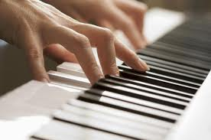
IMPLICIT MEMORY
LONG TERM MEMORY
SUBCONSCIOUS
Not specific
separate from explicit memory
operates through a different process in the brain
Procedural
Automatic sensorimotor behavior
(walking, playing a guitar, shooting baskets)
Emotional Memory (love, fear)
Automatic
Muscle memory (how to hold a pen)
Priming
How deep and how vast is our mind? Is that what dreams are?
Clive Waring: http://www.youtube.com/watch?v=Vwigmktix2Y

Slide 38
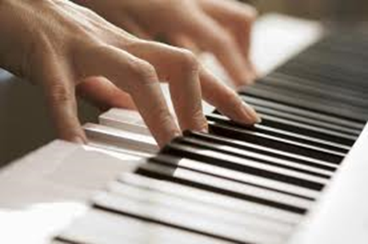
Clive Waring
He has no short-term memory but has implicit memory
Examples of fluctuating between two states of mind,
of being in another state of mind- (in the zone)- but still in a state of awareness

Slide 39
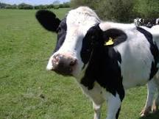
Dreams include images and memories
Episodic Memory
Memories which are actually perceived and known;
Specific
Autobiographical
Emotional, such as love, fear
Includes flashbulb memory
Procedural memory
Procedural is the steps to doing something, or learning to do it
Procedural memory includes muscle memory (how to play piano)
Semantics
general knowledge, NOT unique to individual
symbols and meanings that the symbol emotes
long term memory and implicit
Perceptual memory
Conceptual memory
  Abstract
Notes:
1. Episodic
Memories which are actually perceived and known;
For Ex: An actual memory of riding your bike to school
the day you almost got hit by a car. A distinct memory/event
2. Procedural memory
Procedural is the steps to doing something, or learning to do it; Learning How to ride a bike
3. Semantics
Semantics are long term memory;
it is the symbols and meanings that the symbol emotes (with a feeling), or connects in general to something, but not an actual specific experience or a specific thing.
Semantics are general knowledge
Dreams are filled with metaphors and semantics mixed in with episodic memory and learning
Think of everything we put into our brain, (some of it is your thoughts and some is not. Some is nonsense and some is not) and then think about what ends up in your dreams)

Slide 40
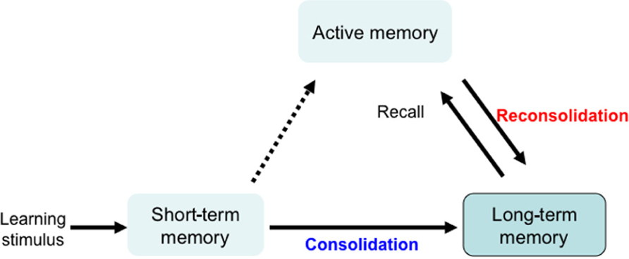
Memory Systems
Synaptic consolidation- within a few hours of learning
(when awake)
Systems consolidation- over days, weeks, maybe months
(when we’re asleep)
Even years later
Memory reconsolidation and Updating consolidation

Slide 41
Sleep is important for memory
sleep before learning, is necessary because it prepares you to learn
the next day
sleep after learning is essential: it grabs onto the new information and cements the information in the neural architecture of the brain.
Sleep is like a save button, protects the memory and strengthens memory
Sleep intelligently cross links large sets of information, seeks out patterns, rules of all that information and creates novel insights.
Problem solving (the expression: sleep on it)
If sleep deprived, about 40% impairment in capacity to learn

Slide 42

  MEMORY TRIAGE: (Acquisition | consolidation)
While we sleep our brain processes new information
in a discriminatory manner
it picks and chooses what to keep
assimilates the memory into a
vast library of evolving knowledge
  Encoding and Sleep Consolidation
  Not everything is remembered-
For information that is retained, sleep integrates it into existing memory by:
  looks for common patterns
  Consolidates memories
  Or, simply cement and strengthen the memory exactly as it was learned

Slide 43
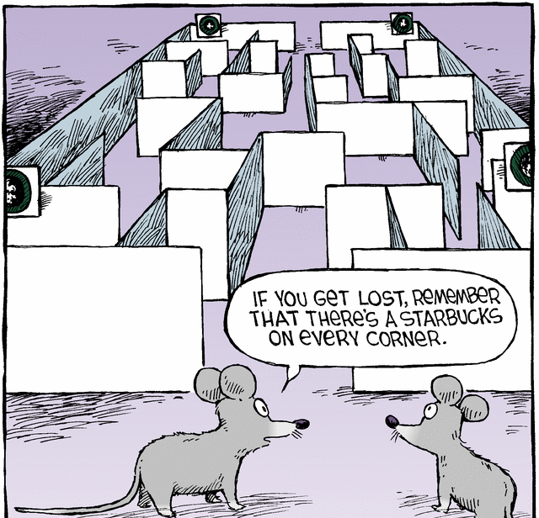
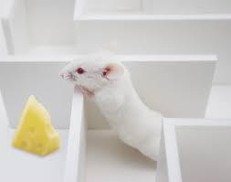
Theory (#2 of 6)
Matt Wilson, MIT Center for Learning and Memory
Dreams Create Wisdom
“Sleep turns a flood of daily information into what we call wisdom:
the stuff that makes us smart for when we come across future decisions”
we encode memory to long-term memory when we sleep
Dreams sort through memories, to determine which
ones to retain and which to lose.
His test: He put rats in mazes during the day & recorded what neurons fired in what patterns as the rats negotiated the maze. In REM sleep, the same neuron patterns fired that had fired at important turning points in the maze.
In other words, he saw that the rats were dreaming of important junctures in their day.

Slide 44
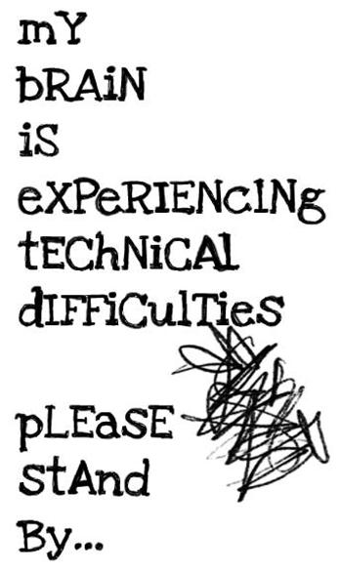
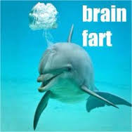
BRAIN FART
Tip of the Tongue

Slide 45
For more information | class one and Two:
The Brain is Predictive
http://sciencevibe.com/2016/03/29/breaking-neuroscience-our-brain-is-an-advanced-prediction-machine/
Black Elk His book: https://en.wikipedia.org/wiki/Black_Elk_Speaks
https://en.wikipedia.org/wiki/Black_Elk
Descartes Three Dreams:
http://physics.weber.edu/carroll/honors/descarte.htm
Dr. Gazziniga: Split brain research
http://www.informationphilosopher.com/solutions/scientists/gazzaniga/
Dr. Gazzinga and Alan Alda -Brains work independently
https://www.youtube.com/watch?v=lfGwsAdS9Dc
The Interpreter Within: The Glue of Conscious Experience
http://www.dana.org/Cerebrum/Default.aspx?id=39343
Dr. Ganziga, split-brain research
http://www.nytimes.com/2011/11/01/science/telling-the-story-of-the-brains-cacophony-of-competing-voices.html?pagewanted=all
Video: http://www.nytimes.com/video/science/100000001142409/michael-gazzaniga.html
http://bigthink.com/users/michaelgazzaniga

Slide 46
For more information | class one and Two:
Split Brain Experiments and Information:
http://www.medclip.com/index.php?page=videos&section=view&vid_id=103271
Psychology Today: http://www.psychologytoday.com/blog/the-superhuman-mind/201211/split-brains
Cal Tech: http://www.its.caltech.edu/~jbogen/text/ref130.htm
Split Brain, Split Mind: http://brainmind.com/Brain3.html
Michael Gazzaniga http://www.nytimes.com/2011/11/01/science/telling-the-story-of-the-brains-cacophony-of-competing-voices.html?pagewanted=all&_r=0
Big Think: 3 videos- http://bigthink.com/users/michaelgazzaniga
(The Criminal Brain. Your Brain is Automatic. You are Free & Your Storytelling Brain)
Legal Responsibility
Center for Law, Brain and Behavior http://clbb.mgh.harvard.edu/criminal-responsibility/
COMA
Coma Patients: http://www.medpagetoday.com/Neurology/HeadTrauma/40947
Do Brain Scans of Comatose Patients Reveal a Conscious State?
http://www.scientificamerican.com/article/do-brain-scans-comatose-patients-reveal-conscious-state/
See Monkey, See monkey Do: Mirror Neuron Research
http://www.psychologicalscience.org/index.php/news/releases/monkey-see-monkey-do-the-role-of-mirror-neurons-in-human-behavior.html
See Monkey, See Monkey Do
http://www.pbs.org/wgbh/nova/education/body/mirror-neurons.html
Mirror Neurons and Intention
http://www.youtube.com/watch?v=Tq1-ZxV9Dc4

Slide 47
MUSIC for listening
Free falling john mayer live (great 4 minutes 10 sec, com)
http://www.youtube.com/watch?v=20Ov0cDPZy8
Learning to Fly live : 5 minutes http://www.youtube.com/watch?v=4p_f7Df2-oM&feature=related
sky sailing Brielle 4. minutes http://www.youtube.com/watch?v=_PkzsMak6P8&ob=nb_av2e
Sleepsong- lord of the rings
http://www.youtube.com/watch?v=VjbCp7w5Oww

Slide 48

Einstein’s dreams
By Alan lightman
Time is relative;
its only worth depends upon
what we do as it is passing
https://www.youtube.com/watch?v=ohIrcwL9GnA

Slide 49
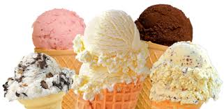
BRAIN FREEZE
sphenopalatine ganglioneuralgia
http://www.medicalnewstoday.com/articles/244458.php

